Slide 1
Project Tittle, Hand gesture recognition for Human-Computer Interaction

Slide 2
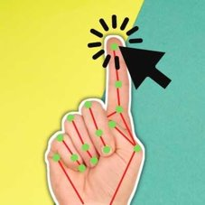
AI Virtual Mouse &
Gesture based Volume Controller
ABSTRACT
Gestures are a natural and intuitive form of both interaction and communication. When we take this idea towards human-computer interaction, we recognise human hand gestures through a camera and assign actions to them. Thus, we get Hand gesture recognition using computer vision.
In light of the pandemic, We aim to use contactless interaction technology
Using computer vision to recognize predefined gestures with a camera and assigning appropriate actions to them in order to create a virtual computer mouse.
Furthermore, we are no longer bound by the limitations of a physical mouse. Hence, we wish to redefine the conventions of operating a computer. Starting with developing a virtual gesture-based volume controller.

Slide 3
Literature Review
Vision based Hand gesture recognition system received great attention in the recent few years because of its myriad of applications.
the ability to interact with machine efficiently through human computer interaction.
It has been used in fields such as vitual reality, gaming, etc to varying degrees of success
Key issues of hand gesture recognition system are presented with challenges of gesture system.
Review methods of recent postures and gestures recognition system presented as well.
Summary of research results of hand gesture methods, databases, and comparison between main gesture recognition phases were also given

Slide 4
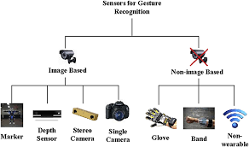
Comparison of Existing methods with merits and demerits
Standard Hand recognition technology uses expensive hardware, Hence, difficult to implement in a large scale.
However, With computer vision,
+ Our project needs only a hand, a camera and a basic computer to function as an AI virtual Mouse.
+ With the right software, it is extremely cost effective and accessible to implement widely, Unlike the 'Kinect' developed by Microsoft.
+ faster to implement and to bring into action in dealing with time sensitive issues such as the Covid-19 pandemic.
- Convineince comes at a cost of accuracy

Slide 5
Challenges to address
Raising Hand Recognition Confidence using any standard camera
Consistency in detection of gestures
Assigning action to gestures
Admin access to system functions such as cursor movement, click automation and volume slider
Dynamic Software to work on any compatitble system with a camera and computer
Improving user interface and experience
Improving accuracy and quality while maintaining feasibility and accessibility.

Slide 6
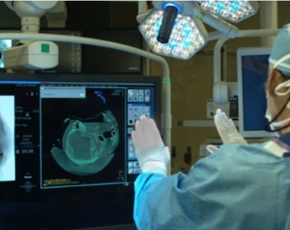
Problem statement And objectives
Covid-19 Era, There is a need for "Contactless" Common equipment
Currently, we have social distancing methods, use of disinfectants to reduce rates of spreading
However, With gesture based 'Little to no contact' systems in place, we reduce points of contact. Thus, Creating a safer environment.
Healthcare
As of now assistants help out with managing systems and this causes crowding in an enclosed place and is counterintuitive
Gesture recognition can help to keep surgical wards sterile. By reviewing the computer without touching the screen, the surgeon can reduce the risk of infection.
Inexpensive accessibility options

Slide 7
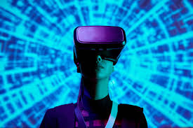
Market potential
Consumer Electronics
Smartphones or TVs with embedded cameras allow us to use our hands to interact with media applications – control the playback of songs or movies. Gestures can be used to play/pause content, increase and decrease volume, mute or unmute sound, or to skip to the next song.
Automotive
gestures can be used for lights control and GPS navigation. The benefit here is mainly improved convenience and user experience, as the driver no longer has to touch around the dashboard trying to find a button to switch radio stations or answer a phone call through the loudspeaker system.
Entertainment
Virtual Reality is another beneficiary of gesture recognition. Most game consoles require controllers, but Kinect proved that it is not required. Using full-body movements can make your whole body a game controller

Slide 8
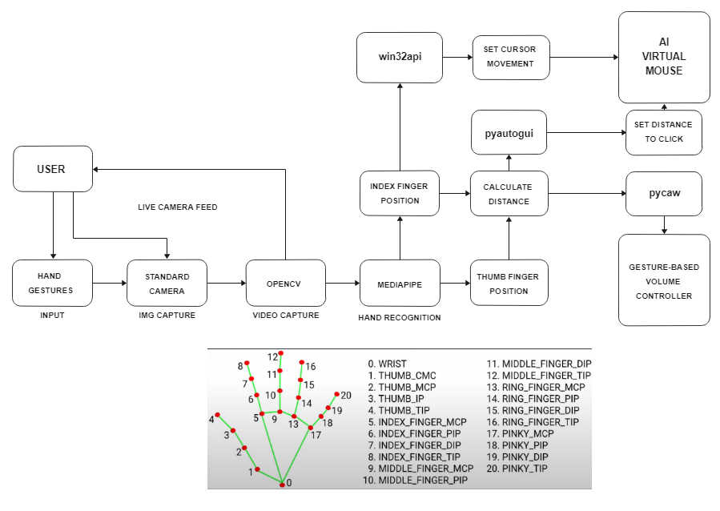
Architecture/ block diagram

Slide 9
Modules Description and Implementation
opencv module is a computer vision librabry that helps with video capture and displaying output.
mediapipe is an open library of ML solutions which we use to recognize hand landmarks.
win32api is used for cursor movement.
PyAutoGUI allows us to use python scripts to control the mouse and keyboard to automate interactions with other applications.
We calculate the distance between the index and the thumb finger in real time.
This distance is used for click automation.
Pycaw helps us access the windows volume slider and uses the same distance range as a volume slider.

Slide 10
Results and discussion
We incorporate years of research done in vision-based hand recognition recognition technology to assign interactive actions to recognised gestures. Thus, we implement human-computer interaction through computer vision.
We aim to develop an project that turns the user's hand into a tool for interacting with computers. We started this as a way to overcome the challenges in a pandemic and now we hope to push into the future of interactive technology.

Slide 11
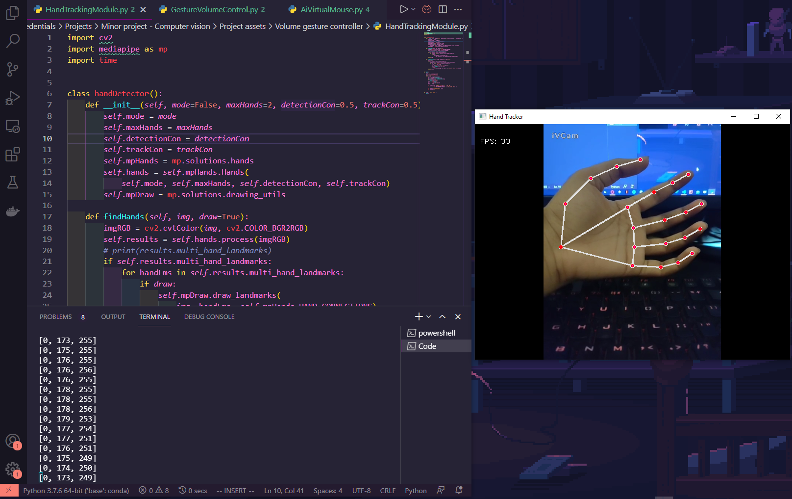
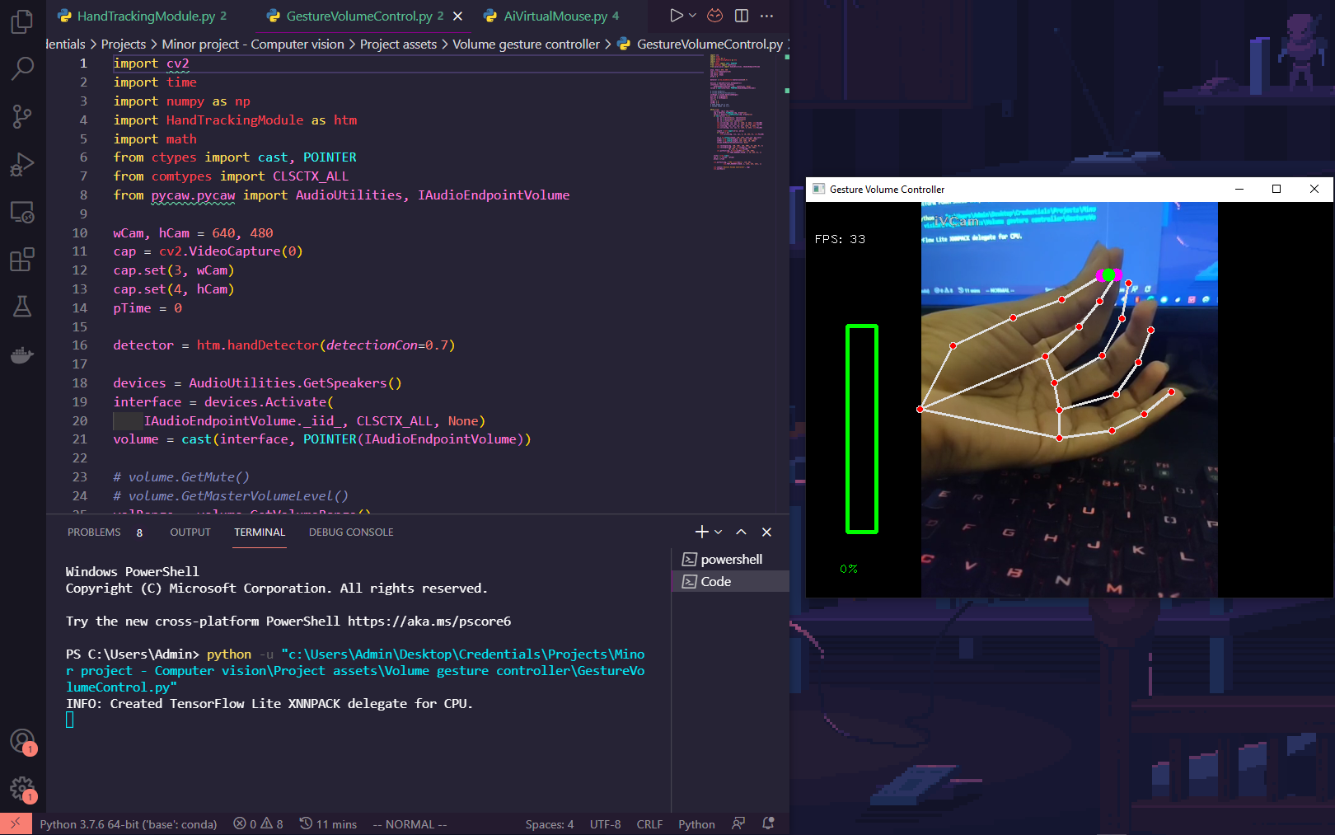
Screenshots

Slide 12
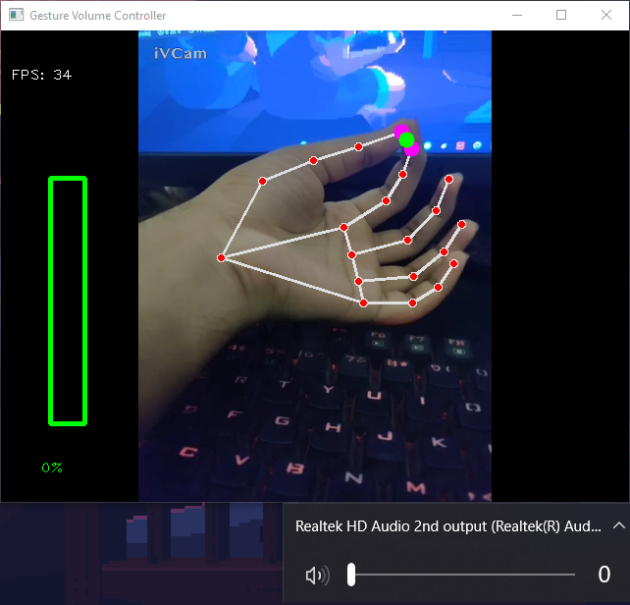
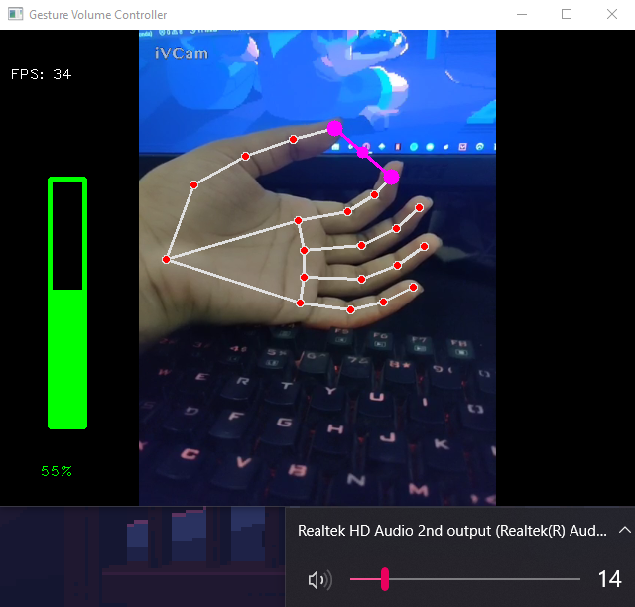
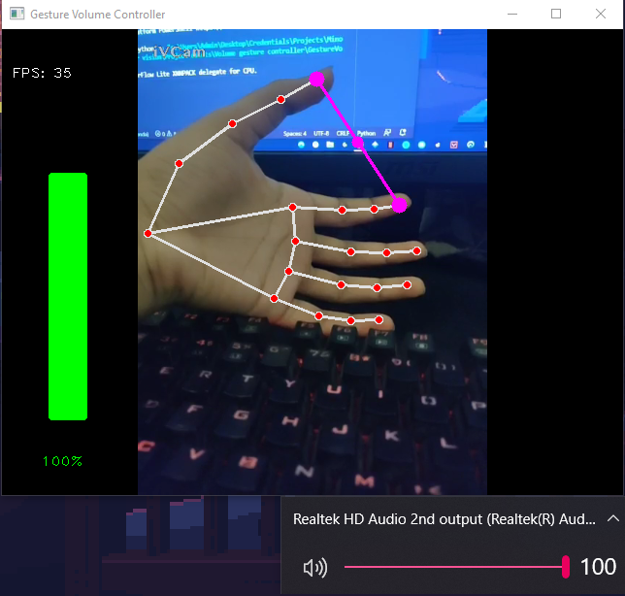
Screenshots

Slide 13
References
Real-time Hand Gesture Recognition System and Application
Hsiang-Yueh Lai,* Hao-Yuan Ke, and Yu-Chun Hsu Department of Electrical Engineering, National Chin-Yi University of Technology, No. 57, Sec. 2, Zhongshan Rd., Taiping Dist., Taichung 41170, Taiwan (R.O.C.) (Received October 30, 2017; accepted January 22, 2018)
Hand-gesture recognition using computer-vision techniques
David J. Rios-Soria Universidad Autónoma de Nuevo León (UANL) San Nicolás de los Garza, NL, Mexico david.j.rios@gmail.com Satu E. Schaeffer Universidad Autónoma de Nuevo León (UANL) San Nicolás de los Garza, NL, Mexico elisa.schaeffer@gmail.com Sara E. Garza-Villarreal Universidad Autónoma de Nuevo León (UANL) San Nicolás de los Garza, NL, Mexico saraelena@gmail.com
Vision based hand gesture recognition for human computer interaction
a survey Siddharth S. Rautaray · Anupam Agrawal

Slide 14
THANK YOU
RA1811003010205 - Kavin Chandar Arthanari Eswaran
RA1811003010157 - Akshat Prakash Srivastava
Mentor/Guide – Gayathri M

